Slide 1
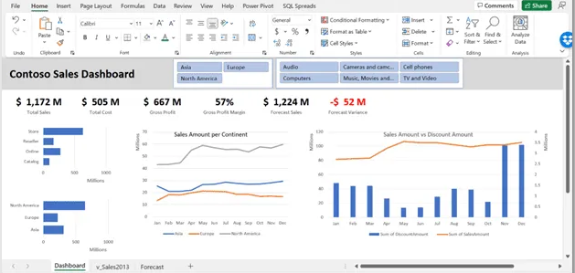
Interactive Dashboard Creation on Amazon Sales Dataset
Presented By
Jayander Prakash

Slide 2

Project Flowchart
Data Cleaning
Data Loading
SQL Query Creation
Visualization of Retrieved Data
Dashboard Execution
Conclusion

Slide 3
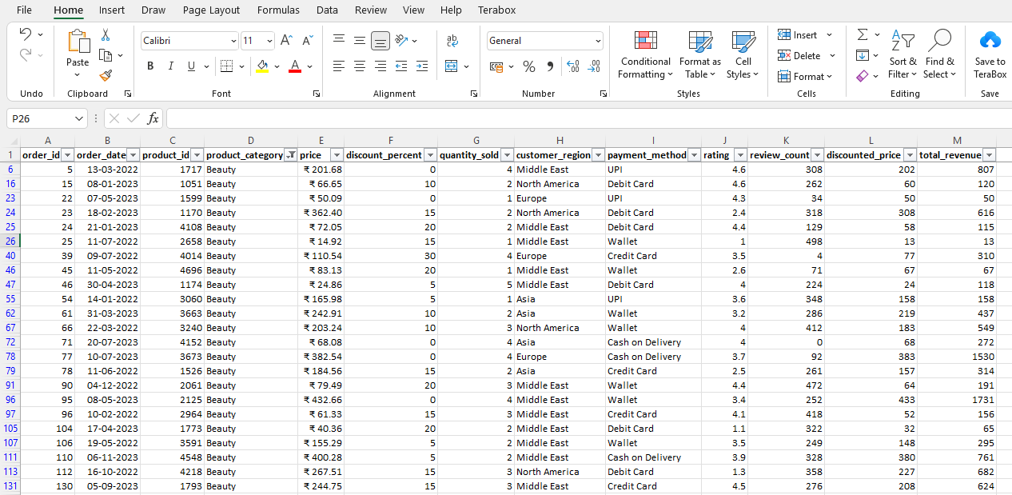
Data Cleaning
Check for Missing Values
Check For Duplicate Values
Normalize Data Types
Execute Data Validation
Perform Spellchecks

Slide 4
Fields Present in the Dataset
Fields Names of Amazon Sales Dataset
Order ID Order Date Product ID Product Category Price Discount Percent Quantity Sold | Customer Region Payment Method Rating Review Count Discounted Price Total Revenue

Slide 5
Average Revenue by Product Category

Slide 6
Revenue By Customer Region

Slide 7
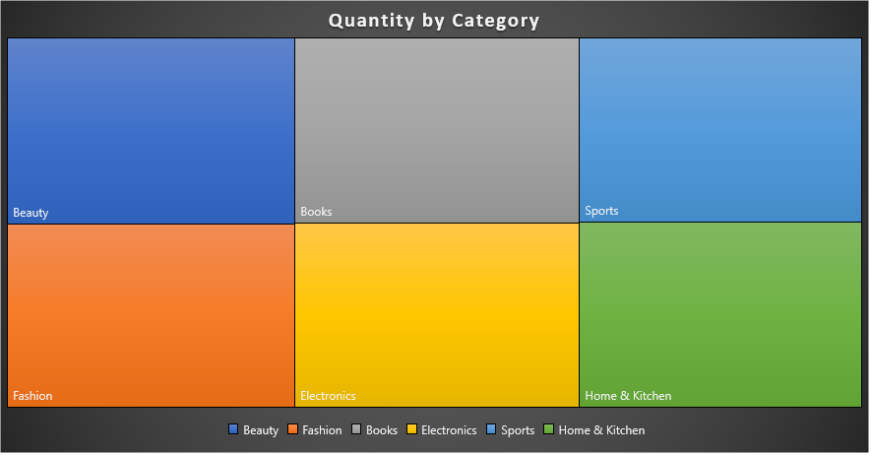
Quantity By Product Category

Slide 8
Products With the Highest Satisfactory Rating

Slide 9
Top 10 Orders By its Revenue Value

Slide 10
Discount Impact on Revenue

Slide 11
Monthly Revenue Trend

Slide 12
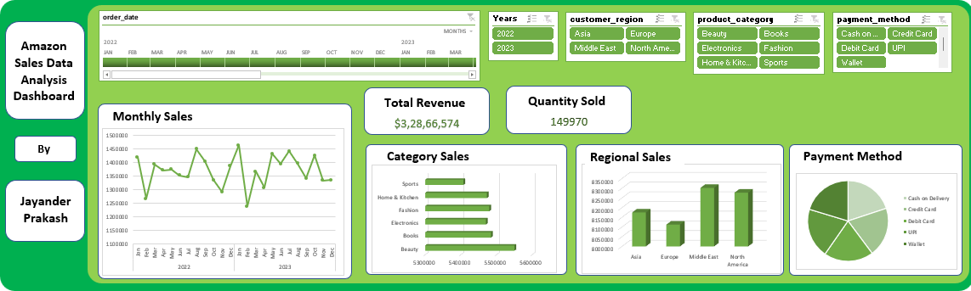
Interactive Dashboard on the Data Analysis

Slide 13

Conclusion
Data cleaning process was executed on the amazon sales dataset.
Cleaned data was loaded into the SQL database.
All the 10 SQL tasks were executed successfully by creating SQL queries.
The outputs of each query was saved in excel format.
Appropriate pivot tables & pivot charts were created.
An interactive dashboard was made on the analyzed data with pivot charts.

